Slide 1
Target Interest Distillation for Multi-Interest Recommendation
Source : CIKM’22
Speaker : yang-YI, LIN
Advisor : Jia-Ling, Koh
Date : 2023/06/27

Slide 2
Outline
Introduction
Method
Experiment
Conclusion

Slide 3
Introduction
Target Interest Distillation for Multi-Interest Recommendation
Multi-Interest Recommendation
Knowledge Distillation

Slide 4
Introduction
Multi-Interest Recommendation
typical sequential recommendation： an overall embedding from sequence
multi-interest recommendation：𝐾 interest embeddings from sequence
Book
Movie

Slide 5
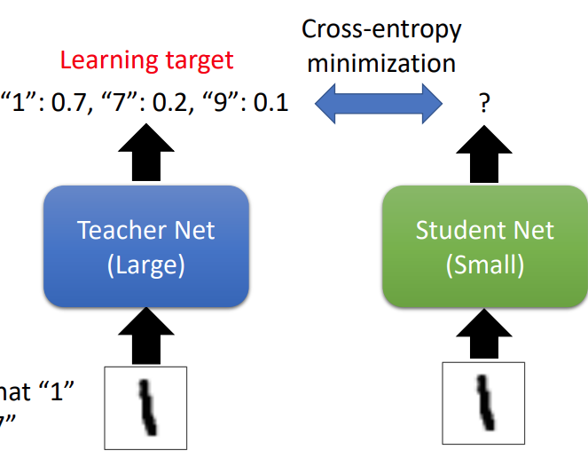
Introduction
Knowledge Distillation

Slide 6
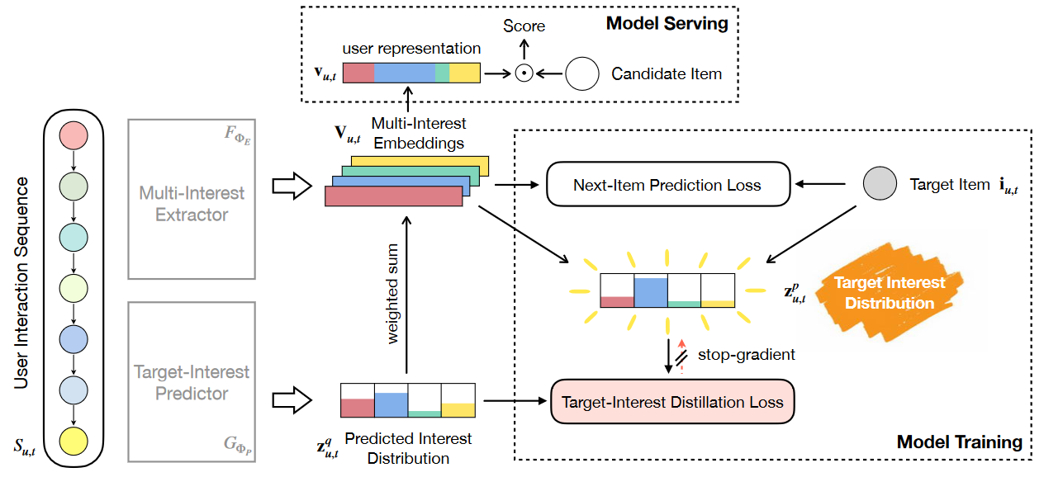
Method--TiMiRec
Target-interest distillation framework for Multi-interest Recommendation

Slide 7
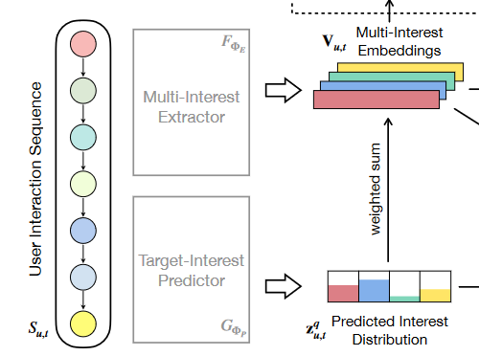
Method
Multi-Interest Extractor：
attention based
item sequence $S_{u,t}$(length 𝑛) -> embeddings H ∈ $R^{D\text{×}n}$
${ ,W}_{1}^{D_{a} × D}, W_{2}^{D_{a} × K}$
multi-interest embeddings ,

Slide 8
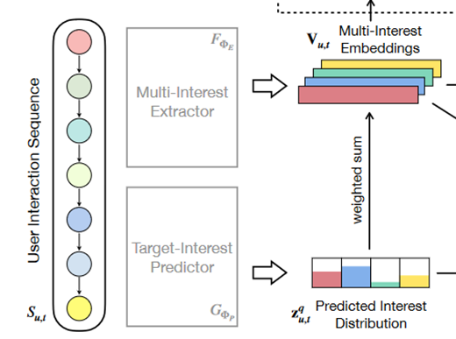
Method
Target-Interest Predictor
item sequence $S_{u,t}$(length 𝑛) -> embeddings H’∈ $R^{D\text{×}n}$
, representation$s_{u,t}$ ∈ $R^{D}$
predicted interest distribution $z_{u,t}^{q}$ ∈ $R^{K}$
(2-layer projection MLP head)

Slide 9
Method
Loss function
multi-interest extractor
user representation

Slide 10
Method
Loss function
target-interest predictor
,

Slide 11
Method
Loss function
$T^{2}$ is balance the two supervision signals

Slide 12
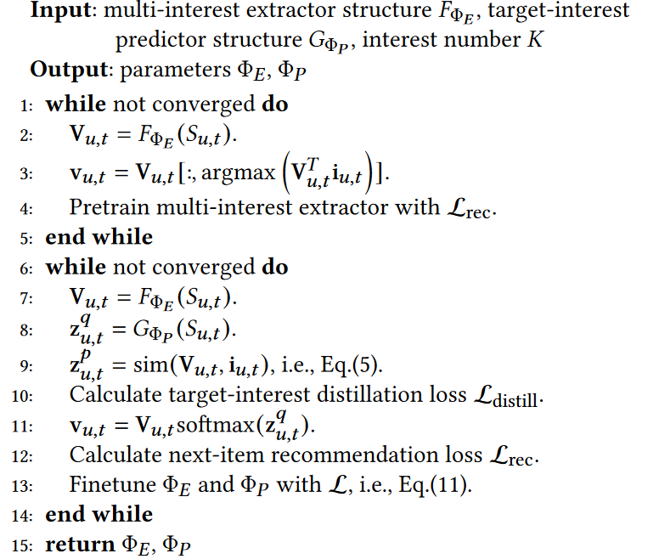
Method
Learning algorithm of TiMiRec
pretrain the multi-interest extractor
Train multi-interest extractor
and target-interest predictor

Slide 13
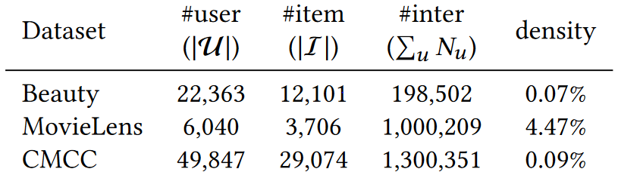
Experiment
Data Set
Beauty：product review datasets from Amazon
MovieLens：user’s ratings for movies
CMCC： video watching activities on smart TV

Slide 14
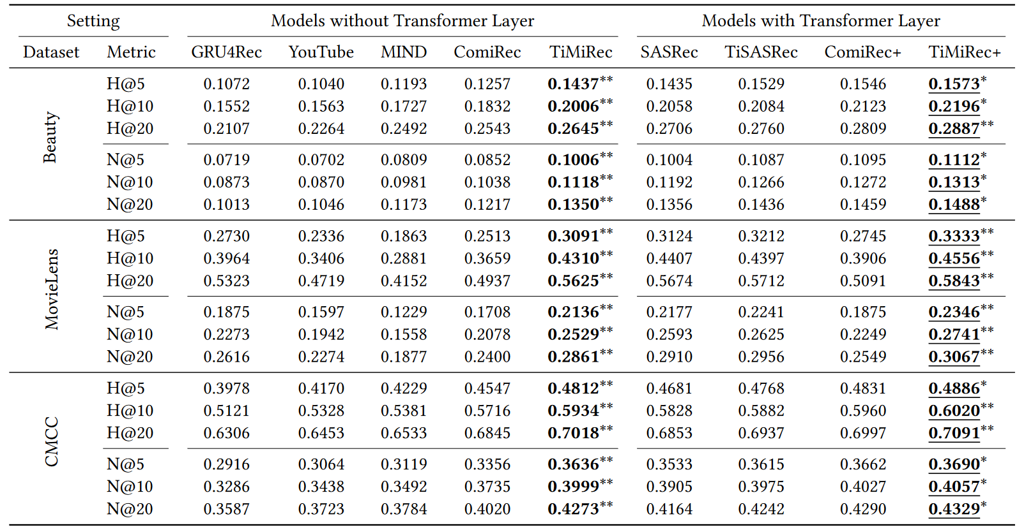
Experiment
Hit Ratio(H) & NDCG(N)
RNN
DNN
multi-interest

Slide 15
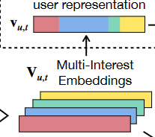
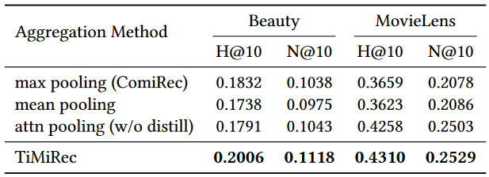
Experiment
Effect of Target-Interest Distillation

Slide 16
Experiment
Further Analysis
joint train：discards the pretraining process
w/o stopgrad：removes the stop-gradient

Slide 17
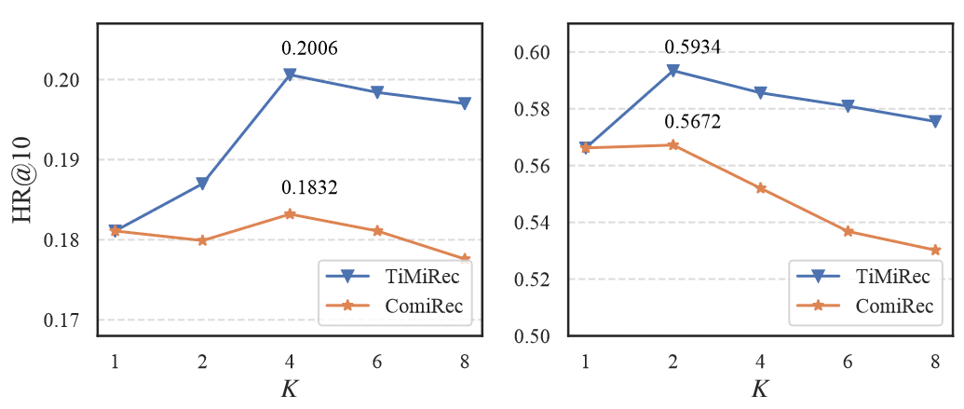
Experiment
changing the interest number 𝐾
Beauty
CMCC

Slide 18
Conclusion
an effective and flexible framework -- TiMiRec
a separate target-interest predictor to infer the interest distribution according to the target context

